Slide 1


SAGAR INSTITUTE OF SCIENCE AND TECHNOLOGY
GANDHI NAGAR BHOPAL
Session – 2024-2025
Branch – CSE AI&DS
(5th SEMESTER)
Subject – Theory Of Computaion
Topic :- Context Sensitive Language
Team Member
Aman Sahu (0187AS221007)
Ankush Gupta (187AS221010)
Ankit Kumbhkar (187AS221009)
SUBMITTED
TO
Dr. Vashima Khan

Slide 2
Introduction:-
Context-sensitive languages (CSL) are a class of formal languages in the theory of computation that lie
between context-free languages and recursively enumerable languages in the Chomsky hierarchy.
What is Context-Sensitive Language?
Context-Sensitive Grammar or Length-Increasing Grammar or Non-contracting Grammar: Ensures the length of
the strings does not decrease during production.It generates Context-Sensitive Languages (CSL)
that are accepted by a Linear Bounded Automaton (LBA).
Why is it important?
- Helps in modeling complex structures in natural and formal systems.
- Relevant in natural language processing and computational theory.

Slide 3
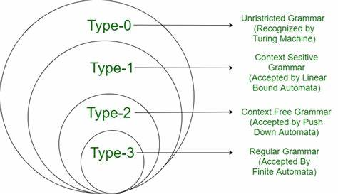
The Chomsky Hierarchy :-
Level | Language Type | Grammar Type | Machine
Type-0 | Recursively Enumerable | Unrestricted Grammar | Turing Machine
Type-1 | Context-Sensitive | Context-Sensitive Grammar (CSG) | Linear Bounded Automaton (LBA)
Type-2 | Context-Free | Context-Free Grammar (CFG) | Pushdown Automaton (PDA)
Type-3 | Regular | Regular Grammar | Finite Automaton (FA)

Slide 4

Characteristics of CSLs
Non-Contracting Grammar | The length of strings cannot decrease during production. Length can stay the same or increase.
Linear Bounded Automaton (LBA) | CSLs are accepted by a Linear Bounded Automaton, a machine that works with limited space.
Context-Sensitive Rules | Rules replace a non-terminal symbol with a string of symbols, but the string's length can never be reduced.
More Expressive than CFLs | CSLs can describe more complex languages than Context-Free Languages (CFLs), but are less powerful than Turing machines.
Challenges of CSLs
Undecidability | It’s Difficult to decide whether a given grammar is context-sensitive or not.
Complexity | Working with CSLs can be very difficult and time-consuming due to their high computational cost.
Limited Tools | There are fewer software tools available for working with CSLs compared to simpler languages like regular or context-free languages.

Slide 5
Formal Definition :-
Context sensitive grammar is defined as 4 tuple
Grammer - {V,T,P,S}
where -
V is set of all Variable's
T is set of all Terminal's
P is set of all Production
S is the start Symbol
A context-sensitive grammar is a formal grammar where every production rule is of the form:
αAβ→αγβ
Here:
A is a non-terminal.
α,β,γ are strings of terminals and/or non-terminals.
γ is non-empty (∣γ∣≥1)

Slide 6
Applications of CSLs
Natural Language Processing | Used to model complex syntactic structures in languages beyond the power of Context-Free Grammars.
Compiler Design | Handles syntax analysis with dependencies and constraints (e.g., variable scope rules).
DNA and Molecular Computing | Represents and simulates DNA behavior with context-sensitive rules.
Theoretical Computer Science | Explores computational boundaries and machine capabilities using Linear Bounded Automata (LBA).

